Slide 1
CS 4530: Fundamentals of Software Engineering Module 08: Concurrency Patterns in Typescript
Adeel Bhutta and Mitch Wand
Khoury College of Computer Sciences
© 2026 Released under the CC BY-SA license

Slide 2
Learning Goals for this Lesson
At the end of this lesson, you should be prepared to:
Explain the difference between JS run-to-completion semantics and interrupt-based semantics.
Given a simple program using async/await, work out the possible orders in which the statements in the program will run.
Write simple programs that create and manage promises using async/await
Write simple programs to mask latency with concurrency by using non-blocking IO and Promise.all in TypeScript.
Notes:
<read slide>

Slide 3
Why async matters
Your browser probably spends 99% of its time waiting
for http requests to return
for database calls to return
Wouldn't it be nice if we could use that waiting time for something else?
maybe we have some other http request we could launch
maybe other things (throbbers??)
async is Typescript's way of handling this

Slide 4
Your app probably spends most of its time waiting
Consider: a 1Ghz CPU executes an instruction every 1 ns
Almost anything else takes approximately forever
Want to utilize this “wasted” time by doing something else
Processing data
Communicating with remote hosts
Timers that countdown while our app is running
Echoing user input
CPU 1
Main Memory
150,000ns (just to read 4KB)
SSD
thread0()
CPU 1 Cache
7ns
100ns
10,000,000ns (just to seek!)
Magnetic HD
~100,000,000ns
Earth to moon: ~16,000,000 inches
Remote Computer (Internet in between)
4
Notes:
First principles: why do we need concurrency?
Mostly I/O. We are spoiled today with huge amounts of RAM, but there are still occasions when you need to read or write something to/from disk, or to/from network.
This diagram shows roughly the overhead of different kinds of I/O, in nanoseconds. Cutting-edge hardware architectures and OS designs aim to reduce these delays, but the rough order of magnitudes still stand.
If we are “computing” things (running instructions on the CPU), on a 1Ghz CPU, that’s nice and round, so you get 1 instruction executed per nano-second. You could run 150k instructions in time to read 4KB from SSD, 10m instructions in time to get the read head on your spinning magnetic HD into place to read something, or 100m instructions in time to receive a packet over internet.
So, it is desirable to be able to keep doing things while we are waiting for I/O, and not stop the world. Another way to put this, is that we would like to mask this latency to do such slow operations with concurrency: do something else while these I/O operations are happening.

Slide 5
Typescript/Javascript achieves this goal using two techniques: 1. cooperative multiprocessing 2. non-blocking IO

Slide 6
Most OS's use pre-emptive multiprocessing
OS manages multiprocessing with multiple threads of execution
Processes may be interrupted at unpredictable times
Inter-process communication by shared memory
Data races abound
Really, really hard to get right: need critical sections, semaphores, monitors (all that stuff you learned about in op. sys.)
Notes:
In many programming languages, like Java or C, you can have asynchronous computation with threads.
You might be familiar with this programming model. As it turns out, the “inter-process communication by shared memory” part is extremely hard to get right, and almost impossible to prove correct
This is not how JS or TS does asynchronous computation.

Slide 7
Javascript/Typescript uses cooperative multiprocessing
In cooperative multiprocessing, only one process is executed at a time.
Each process pauses when it is convenient to allow other processes to make progress.
To make this practical (and avoid cheating!), we need a programming model that encourages this behavior
Notes:
In cooperative multiprocessing, each thread decides when it should yield to let other threads execute. For the purposes of this lecture, we will use the terms 'promise' and 'computation' interchangeably (MAYBE??)

Slide 8
async/await is a programming model for cooperative multiprocessing
In async/await, the program is organized into a set of "async functions“
An async function is like an ordinary function, except that it may be executed by webAPI or the browser
If you await on async function, it can pause the execution until async function is completed. This is also known as a ‘promise’. We will show you those with an example.
When one program pauses, the runtime can choose to resume executing any process that is ready to run.

Slide 9
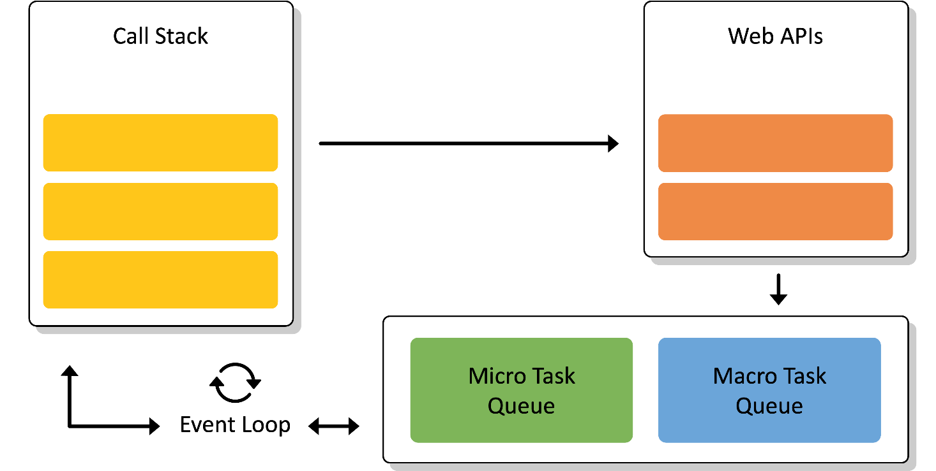
How does JS Event Loop make this happen?
One Event Loop means that we have single thread of execution
WebAPI are often used for asynchronous tasks
Queues are used for “await”-ing tasks
When call stack gets empty, event loop picks up tasks from Callback Queues
Microtask queue has priority over macrotask queue
Notes:
<read slide>.
- JS Engine includes a {single} call stack that keeps track of each function that it is being executed
- Asynchronous (heavy) tasks are outsourced to WebAPI. When those are completed, they are placed in a callback queue.
- Event loop picks up “awaiting” {completed} tasks from queue when call stack is empty (i.e., when it is done with everything it was working on – think run to completion) and processes them in the order they were added to queue (i.e., they were completed by WebAPI)

Slide 10
Run to Completion is a central concept
In JS, you work on one and one task only (i.e., event loop has a single call stack)
Also, if you start a task, you must finish it (i.e., call stack must be emptied) before you start another task. This pattern is called "run-to-completion" semantics
A pause point will correspond to each await keyword which allows you to work on a different unit of work.
You can do lots of different things with promises.
Let's look some typical patterns.
Notes:
run to completion means that if you start executing a task (or async) function then it must complete unless it awaits on something

Slide 11
A typical async function
async function someFunction(i: number) {
const j = i + 1;
// ...
const k = await someOtherAsyncFunction(j);
// ...
const m = k + 100
return m;
}
Notes:
Here's a typical async function. It calls another async function, waits for that function to return, and then does something with the answer. The "cooperative multiprocessing" means that while this function is waiting for the other function to return, the runtime can switch to some other task. But there can be no interruptions while we are executing the code in this function. Let's look at that idea in more detail.

Slide 12
Execution of an async function may be paused
async function someFunction(i: number) {
const j = i + 1;
// ...
const k = await someOtherAsyncFunction(j);
// ...
const m = k + 100
return m;
}
It will never pause in
here. This is called a
Critical Section
Or in here (this is
another Critical Section)
Notes:
By disallowing interrupts everywhere but at the pause points, we avoid almost all of the data races you may have learned about in your operating systems class. Each grey box is a critical section, and your program consists of a set of critical sections. Each green box is uninterruptible!!

Slide 13

What happens at those pause points?
async function someFunction(i: number) {
const j = i + 1;
// ...
const k = await someOtherAsyncFunction(j);
// ...
const m = k + 100
return m;
}
Pause points
Notes:
An async function yields or pauses in exactly two places in its code. What happens at those places?
When someFunction yields at the first location, it first informs the runtime that someOtherAsyncFunction(j) is ready to run, and that someFunction will be ready to resume its execution only when someOtherAsyncFunction(j) returns a value (i.e., it is returning to caller with a pending promise). The runtime can then switch to any process that is ready.
When someFunction yields at the second location, it informs the runtime that it is ready to return to its caller, and the runtime will switch to any process that is ready. It might be the caller of someFunction, or it might be something else.

Slide 14
What happens when you await?
When you ‘await’ on an asynchronous task, you are cooperating with the event loop by allowing it to work on something else.
In technical terms, you are returning with a pending promise which means that some work will be completed in future.
While you are waiting for that future, event loop will continue finishing its current task (whatever is in call stack) and then other tasks (whatever is in callback queue).
Eventually you will return to complete the awaited work
Let’s understand those with some examples
Notes:
run to completion means that if you start executing a task (or async) function then it must complete unless it awaits on something

Slide 15
Java vs. JS/TS
src/Slides/dataRace2.ts
async function asyncPrintA() {
await waitRandom(1);
console.log('A');
}
async function asyncPrintBC() {
await waitRandom(2);
console.log('B');
console.log('C');
}
async function run() {
await Promise.all([asyncPrintA(), asyncPrintBC()])
}
run()
In Java, you could get an interrupt between the print B and the print C.
So the output could be ABC, BAC, BCA
In TS/JS, the print B and print C are in the same critical section, so BAC is impossible!
Notes:
In an interrupt-based model, it is possible that statement the print A runs *between* the print B and the print C. Not for us!
(Don't worry about the details of the run() procedure-- we'll explain that soon).

Slide 16
A promise can be in one of exactly 3 states
A JavaScript promise can be in one of three states: pending, fulfilled, or rejected.
Pending is the initial state where the promise is waiting for an operation to complete; Then it becomes Ready for Execution; and eventually it is Executing before being resolved
Resolved: either fulfilled or rejected.
fulfilled means the operation was successful,
rejected indicates that the operation failed.
Notes:
<read slide>. Say something about success/failure?

Slide 17
Simple sequential execution:
src/Slides/newRequest.ts
// simple synchronous execution
async function main() {
console.log('main started');
console.log(`sync task`);
console.log('main done');
}
main()
Everything runs sequentially
$ node newRequest.ts
main started
Sync task
main done
Notes:
Nothing new here, everything runs in order. Each console log gets pushed onto call stack and then popped when executed

Slide 18
Async task can finish later
src/Slides/newRequest.ts
// simple synchronous execution
async function main() {
console.log('main started');
console.log(`sync task`); setTimeout(() => {
console.log('timeout');
}, 0);
console.log('main done');
}
main()
$ node newRequest.ts
main started
sync task
main done
timeout
Run to completion requires main to finish first
setTimeout was given to WebAPI
Notes:
setTimeout is given to webAPI for execution which will place the console.log('timeout’) onto callback queue. Run to completion requires main to finish first then execute the call back. Strictly speaking: you have a pending promise to executed a callback at some point after the timer expires. This callback will be placed in Macroqueue until call stack can execute it.

Slide 19
Promise can also be resolved in future
src/Slides/newRequest.ts
// simple synchronous execution
async function main() {
console.log('main started');
console.log(`sync task`); Promise.resolve().then( () => {
console.log('promise');
} );
console.log('main done');
}
main()
$ node newRequest.ts
main started
sync task
main done
promise
Notes:
Promise will work the same way, with console.log(‘promise’) getting placed on Microtask queue. Run to completion requires main to finish first then execute the call back.

Slide 20
Promises have priority (Micro over Macro)
src/Slides/newRequest.ts
// simple synchronous execution
async function main() {
console.log('main started');
console.log(`sync task`); Promise.resolve().then( () => {
console.log('promise');
} );
setTimeout(() => {
console.log('timeout');
}, 0);
console.log('main done');
}
main()
$ node newRequest.ts
main started
sync task
main done
promise
timeout
Notes:
Since MicroTask queue has priority over microtask queue, callback for promise will get executed first before callback for timer, after callstack is emptied out by finishing main.

Slide 21
You can await on async tasks (1)
src/Slides/oneRequest.ts
// fakeRequest(n) is an async that waits for 1 second and then
// resolves with the number n+10
import { fakeRequest } from "./fakeRequest";
import { timeIt } from "./timeIt";
async function main() {
console.log('main started');
const res = await fakeRequest(32);
console.log(`fakeRequest(${request}) returned: ${res}`);
console.log('main done');
}
timeIt(main)
export function fakeRequest(n: number): Promise<number> {
return new Promise((resolve, reject) => {
console.log('fakeRequest received request:', n);
setTimeout(() => {
console.log('time passes....');
resolve(n + 10);
}, 1000);
});
}
$ node oneRequest.ts
main started
fakeRequest received request: 32
time passes....
fakeRequest(32) returned: 42
main done
1015.98 msec
Notes:
Review the code. main() waits for the request to return, and then continues. Awaiting allows us to wait for some task to complete first before we do something else.

Slide 22
You can await on async tasks (2)
src/Slides/oneRequest.ts
// makeRequest is a utility function to simulate API requests and // then response
import { makeRequest } from "./fakeRequest";
import { timeIt } from "./timeIt";
async function main() {
console.log('main started');
await makeRequest(12);
console.log('main done');
}
timeIt(main)
export async function makeRequest(requestNumber:number) {
console.log(`starting makeRequest(${requestNumber})`);
const response = await fetch('https://rest-example.covey.town');
console.log('request:', requestNumber, '; response:', response.data);
}
$ node oneRequest.ts
main started
starting makeRequest(12)
request: 12
response: This is GET number 190 on the current server
main done
264.65 msec
Notes:
Review the code. main() waits for the request to return, and then continues.

Slide 23
Pattern for starting a concurrent computation using non-blocking I/O
src/Slides/makeOneRequests.ts
export async function makeRequest(requestNumber:number) {
console.log(`starting makeRequest(${requestNumber})`);
const response = await fetch('https://rest-example.covey.town');
console.log('request:', requestNumber, '; response:', response.data);
}
The first console.log is printed
The http request is immediately sent, using non-blocking i/o. The browser goes about its business
A pending promise is returned to the caller. Caller can continue its other business.
Eventually, the fetch returns.
Some time after that, the console.log is printed and the makeRequest concludes.
Any promises that are waiting for the result of this makeRequest become eligible for execution.
Notes:
It is important to note that you can call makeRequest but it will be awaiting a future response. That promise was returned immediately back to the caller (whichever promise called the makeRequest) and that the caller’s thread continues on while makeRequest is waiting for a response, just as in our previous examples.

Slide 24
Running 3 concurrent fetch requests (start)
src/Slides/makeThreeConcurrentRequests.ts
import axios from 'axios'; export async function makeRequest(requestNumber:number) {
console.log(`starting makeRequest(${requestNumber})`);
const response = await fetch('https://rest-example.covey.town');
console.log(`request:${requestNumber} returned`);
} function make3ConcurrentRequests() {
console.log('starting make3ConcurrentRequests');
makeRequest(100);
makeRequest(200);
makeRequest(300);
console.log('make3ConcurrentRequests finished');
} make3ConcurrentRequests()
console.log (‘starting makeR…’)
fetch('https://rest…');
makeRequest (100)
console.log(‘starting make3 …’);
P1
make3ConcurrentRequests
Now, makeRequest(200) can proceed …
Response from fetch
Notes:
Here, just to make the output easier to read, we've simplified makeRequest so that it prints out only the number of the request that was responded to.
Note that the responses don't arrive in the same order that they were sent!

Slide 25
Running 3 concurrent fetch requests (end)
src/Slides/makeThreeConcurrentRequests.ts
import axios from 'axios'; export async function makeRequest(requestNumber:number) {
console.log(`starting makeRequest(${requestNumber})`);
const response = await fetch('https://rest-example.covey.town');
console.log(`request:${requestNumber} returned`);
} function make3ConcurrentRequests() {
console.log('starting make3ConcurrentRequests');
makeRequest(100);
makeRequest(200);
makeRequest(300);
console.log('make3ConcurrentRequests finished');
} make3ConcurrentRequests()
console.log(‘make3… finished’);
P1
P2
P3
make3ConcurrentRequests
Responses from fetch 1, 2, 3
Notes:
Here, just to make the output easier to read, we've simplified makeRequest so that it prints out only the number of the request that was responded to.
Note that the responses don't arrive in the same order that they were sent!

Slide 26
Running 3 concurrent fetch requests
src/Slides/makeThreeConcurrentRequests.ts
import axios from 'axios';
export async function makeRequest(requestNumber:number) {
console.log(`starting makeRequest(${requestNumber})`);
const response = await fetch('https://rest-example.covey.town');
console.log(`request:${requestNumber} returned`);
}
function make3ConcurrentRequests() {
console.log('starting make3ConcurrentRequests');
makeRequest(100);
makeRequest(200);
makeRequest(300);
console.log('make3ConcurrentRequests finished');
}
make3ConcurrentRequests()
$ node makeThreeConcurrentRequests.ts
starting make3ConcurrentRequests
starting makeRequest(100)
starting makeRequest(200)
starting makeRequest(300)
make3ConcurrentRequests finished
request 300 returned
request 100 returned
request 200 returned
3 requests may finish in any order
Notes:
Here, just to make the output easier to read, we've simplified makeRequest so that it prints out only the number of the request that was responded to.
Note that the responses don't arrive in the same order that they were sent!

Slide 27
If you add awaits, the requests will be processed sequentially
$ node threeRequestsSequentially.ts
starting main
fakeRequest received request: 1
time passes....
fakeRequest(1) returned: 11
fakeRequest received request: 2
time passes....
fakeRequest(2) returned: 12
fakeRequest received request: 3
time passes....
fakeRequest(3) returned: 13
main done
3024.03 msec
async function main() {
console.log('starting main');
const res1 = await fakeRequest(1);
console.log(`fakeRequest(1) returned: ${res1}`);
const res2 = await fakeRequest(2);
console.log(`fakeRequest(2) returned: ${res2}`);
const res3 = await fakeRequest(2);
console.log(`fakeRequest(2) returned: ${res3}`);
console.log('main done');
}
timeIt(main)
src/Slides/threeRequestsSequentially.ts
Notes:
By contrast, here we wait for each request to return before issuing the next one. Each fakeRequest takes 1000 msec, and we can see that the whole thing took 3000 msecs-- no concurrency here!

Slide 28
Use Promise.all to execute several requests concurrently
src/Slides/threeRequestsConcurrently.ts
async function main() {
console.log('starting main');
const promises = [fakeRequest(1),
fakeRequest(2),
fakeRequest(3)];
const results = await Promise.all(promises);
console.log('results:', results);
console.log('main done');
}
timeIt(main)
$ node threeRequestsConcurrently.ts
starting main
fakeRequest received request: 1
fakeRequest received request: 2
fakeRequest received request: 3
time passes....
time passes....
time passes....
results: [ 11, 12, 13 ]
main done
1018.81 msecno
3 requests may finish in any order
Notes:
Here's an example of starting several requests concurrently. Remember that each call to fakeRequest() takes 1 second (1000 msecs), and here we completed 3 of them in just over 1 second. So something in these three requests must have run concurrently.
In this case, it was the timers in the three fakeRequests that ran concurrently. Had this been a real request (say an http request or a database fetch), those requests would be "in-flight" concurrently. We'll see this in more detail in a few minutes.
Note that if any of the promises fail, then the Promise.all fails (we'll talk about promise failure a little later).

Slide 29
…but it would be much slower
$ tsx timeComparison.ts
After 100 runs of length 10 with delay 100ms
makeRequestsConcurrently: min = 107 avg = 109 max = 115 msec
makeRequestsSerially : min = 1085 avg = 1093 max = 1103 msec
Notes:
We should leverage concurrency whenever possible.
(Time is average of 100 runs on Prof. Wand’s Lenovo X1)

Slide 30
Why is that? Visualizing Promise.all
“Don’t make another request until you got the last response back”
Sequential (await)
237 msec
send
wait
receive
send
wait
receive
send
wait
receive
“Make all of the requests now, then wait for all of the responses”
Concurrent (Promise.all)
34 msec
send
wait
receive
or
send
wait
receive
send
wait
receive
send
wait
receive
send
wait
receive
send
wait
receive
Notes:
In both cases, there is at most one active promise (in green) at any time! But the concurrent version "masks latency with concurrency", as we said way back on slide 1.

Slide 31
Requests can also be chained (if they are serial)
async function main() {
console.log('main started');
const request1 = 32
const res1 = await fakeRequest(request1);
console.log(`fakeRequest(${request1}) returned: ${res1}`);
const res2 = await fakeRequest(res1);
console.log(`fakeRequest(${res1})returned: ${res2}`);
const res3 = await fakeRequest(res2);
console.log(`fakeRequest(${res2})returned: ${res3}`);
console.log([request1, res1, res2, res3]);
console.log('main done');
}
$ node threeRequestsChained.ts
main started
fakeRequest received request: 32
time passes....
fakeRequest(32) returned: 42
fakeRequest received request: 42
time passes....
fakeRequest(42)returned: 52
fakeRequest received request: 52
time passes....
fakeRequest(52)returned: 62
[ 32, 42, 52, 62 ]
main done
3080.99 msec
src/Slides/threeRequestsChained.ts
Notes:
In the examples so far, the arguments to the requests were independent of each other. But there's no reason they have to be independent (except for Promise.all). You can make them any way you need to.

Slide 32
Recover from errors with try/catch
// a request that may fail
async function maybeFailingRequest(req: number): Promise<number> {
const res = await fakeRequest(req);
if (res < 0) {
throw new Error(`Request ${req} failed because response ${res} < 0`);
} else {
return res;
}
}
src/Slides/tryCatchExample.ts
Notes:
asyncs play nicely with try/catch. Here we've tweaked fakeRequest so that it will sometimes throw an error, and here's a wrapper that recovers from those errors (by returning 0).

Slide 33
try/catch, continued
async function main() {
console.log('main started');
const req1 = -32
let res: number;
try {
res = await maybeFailingRequest(req1);
console.log(`fakeRequest(${req1}) returned: ${res}`);
} catch (err) {
console.error(`Error occurred for request ${req1}`);
res = 0
}
console.log('main done with res =', res);
}
timeIt(main);
$ node tryCatchExample.ts
main started
fakeRequest received request: -32
time passes....
Error occurred for request -32
main done with res = 0
1007.52 msec

Slide 34
Pattern for testing an async function
import { fakeRequest } from './fakeRequest.ts'
import { describe, expect, test} from 'vitest'
// fakeRequest should make a network request using myFetch
// and then returns n + 1
describe('fakeRequest', () => {
test('fakeRequest should return its argument + 1 (await/expect)', async () => {
expect.assertions(1)
await expect(fakeRequest(100)).resolves.toEqual(101)
})
test('fakeRequest should return its argument + 1 (expect/await)', async () => {
expect.assertions(1)
expect(await fakeRequest(7)).toEqual(8)
})
src/Slides/example.test.ts
Notes:
Let's change the subject. How do you test an async function? To test an async function, make the second argument to ‘test’ an async function. This will make ‘expect’ itself an async function, so you will need to ‘await’ its result. Calling expect.assertions checks to make sure that your test properly awaited the the result of the request.
This example is easy, since we are only sending some data to a public web site. If we wanted to do something that might have a global effect (e.g. a transcript database), we'd have to do some mocking. Alas, that is too much for this lecture ☺.
Here, echo is an async function, so it returns a promise, which should eventually return a string (here “33”) to the async function that called it (here, the expect). So here we are saying that we expect echo(33) to return a promise that will eventually resolve to “33”.
Note the await on the next to last line. If you leave that out, the async function in the test will succeed immediately, without waiting for the expect to run. The expect.assertions (in blue) tells Jest that the test should run exactly 1 test, so that will make the test fail if you leave out the await.

Slide 35
AntiPattern 1: unawaited promise
src/Slides/oneRequestNoAwait.ts
// fakeRequest(n) is an async that waits for 1 second and then
// resolves with the number n+10
import { fakeRequest } from "./fakeRequest";
import { timeIt } from "./timeIt";
async function main() {
console.log('main started');
const request = 32
const res = fakeRequest(request);
console.log(`fakeRequest(${request}) returned: ${res}`);
console.log('main done');
}
timeIt(main)
$ node oneRequestNoAwait.ts
main started
fakeRequest(32) returned: [object Promise]
main done
2.64 msec
fakeRequest received request: 32
time passes....
Notes:
Review the code.

Slide 36
What just happened?
$ node oneRequestNoAwait.ts
main started
fakeRequest(32) returned: [object Promise]
main done
2.64 msec
fakeRequest received request: 32
time passes....
main() called fakeRequest(32).
fakeRequest(32) created a unit of work (a Promise), and told the runtime to run it sometime or other.
Normally, we wouldn't see the actual value returned by fakeRequest(32), because we'd just wait for the unit of work to run before proceeding.
But here, we didn't wait-- we just took the value returned by fakeRequest(32)-- the Promise-- and printed it.
We finished our current unit of work, printing "main done", which informed the runtime that we were done.
The runtime then looked around for another unit of work to do. In this case, it found the unit of work created by fakeRequest(32), and ran it, printing the last two lines
Notes:
OK, this is complicated (which is why it's an antipattern). Here's what happened:
main() called fakeRequest(32).
fakeRequest(32) created a unit of work (a Promise), and told the runtime to run it sometime or other.
Normally, we wouldn't see the actual value returned by fakeRequest(32), because we'd just wait for the unit of work to run before proceeding.
But here, we didn't wait-- we just took the value returned by fakeRequest(32)-- the Promise-- and printed it.
We finished our current unit of work, printing "main done", which informed the runtime that we were done.
The runtime then looked around for another unit of work to do. In this case, it found the unit of work created by fakeRequest(32), and ran it, printing the last two lines

Slide 37
Wow! That was complicated!
We try to make our code easy to understand.
That's why it's an antipattern.
Luckily, in real code we don't need to do this very often
is complicated (which is why it's an antipattern). Here's what happened:

Slide 38
AntiPattern 2: Side-effect before await can be misleading
src/Slides/antiPattern2.ts
Critical Section #1: no interruption between 'f started' and 'g started'
async function f() {
console.log('f started');
await g();
console.log('f done');
}
async function g() {
console.log('g started');
const res = await fakeRequest(32);
console.log(`fakeRequest(32) returned: ${res}`);
}
Critical Section #2
Critical Section #3
Notes:
Before, we marked the critical sections in a single async function. When we consider two or more asyncs, the story is a little more complicated-- the two green sections actually form a single critical section, so the 'f started' will *always* be followed immediately by the 'g started'. (And if there was a side-effect at the start of fakeRequest, that would similarly follow immediately after the 'g started'. But there isn't ☺ ) .
The 'g started' exposes this subtlety-- if it wasn't there, you'd never be able to tell the difference. So don't do that. Make sure that nothing you do before the first await in your async causes a visible side-effect (e.g. a console.log), unless you really want to track what's going on at this level of detail.

Slide 39
We achieve this goal using two techniques: 1. cooperative multiprocessing 2. non-blocking IO
But where does the non-blocking IO come from?
Notes:
That concludes our tour of cooperative multiprocessing.
But where does the non-blocking IO come from?

Slide 40
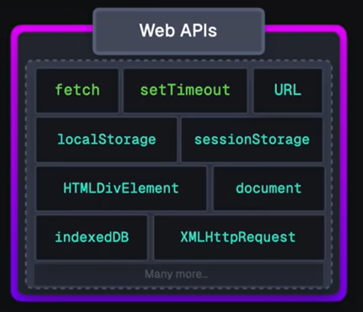
Answer: JS/TS has some primitives for starting a non-blocking computation
These are things like http requests, I/O operations, or timers.
Each of these returns a promise that you can await. The promise runs while it is pending, and produces the response from the http request, or the contents of the file, etc.
You may use some of these directly, like fetch or setTimeout.
More frequently, you will invoke these using a convenient library, like
axios.get('https://rest-example.covey.town’)
to make an http request, or
fs.readFile(filename)
to read the contents of a file.
Notes:
This is what we said back on the slide with the stork, where we said "Some typescript libraries have API procedures that return promises"

Slide 41
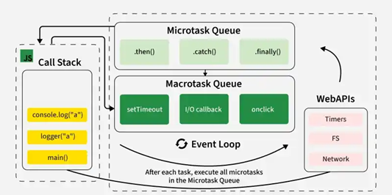
Let’s put it all together
JS/TS has single event loop
We outsource most of the work to WebAPIs for asynchronous work
Upon completion, they are placed in queues.
Event loop picks them up from queue when call stack is empty!
Notes:
Javascript is a single threaded language. This means it has one call stack and one memory heap. It uses WebAPI to work asynchronously.
How do we get asynchronous code with Javascript then?
Well, we can thank the Javascript engine (V8, Spidermonkey, JavaScriptCore, etc...) for that, which has Web API that handle these tasks in the background. The call stack recognizes functions of the Web API and hands them off to be handled by the browser. Once those tasks are finished by the browser, they return and are pushed into a queue (callbacks go in Macrotask queue and promises go into microtask queue)
Then they are picked up by the event loop one by one and added onto the call stack.
Try this http://latentflip.com/loupe

Slide 42
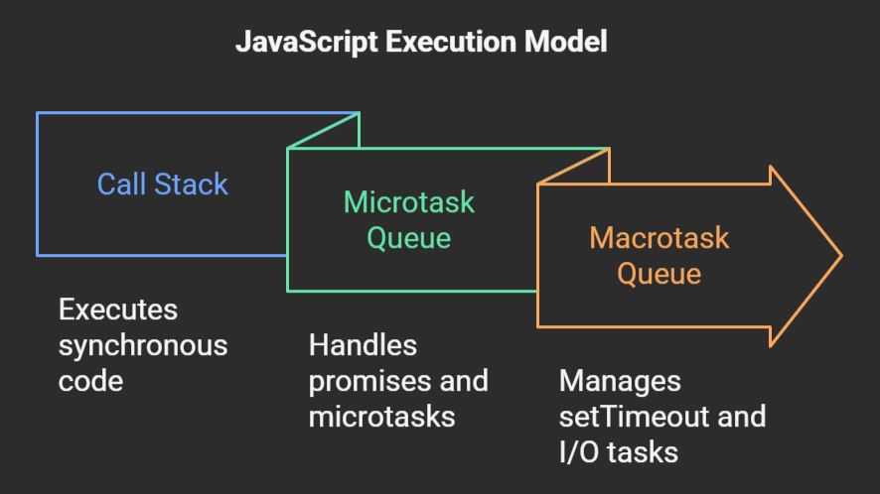
Microtasks are urgent and Macrotasks are slower/asynchronous operations
Microtask queue is used for immediate/urgent tasks while Macrotask queue is used for slower asynchronous tasks.
When call stack is empty, microtask queue is processed first (before browser renders). When microtask queue is empty then macrotask queue is processed.
Notes:
JavaScript microtasks (Promises, MutationObserver) have higher priority than macrotasks (setTimeout, I/O), executing immediately after the call stack empties and before the next event loop iteration. The event loop processes all available microtasks before running a single macrotask.
Key Differences at a Glance:
Priority: Microtasks are executed immediately after the current task and before the browser renders, while macrotasks are processed one by one, allowing rendering to happen between them.
Order: If a microtask adds another microtask, it is executed in the same cycle. If a macrotask adds a microtask, it is also executed before the next macrotask.
Usage: Microtasks are for urgent, immediate post-processing (e.g., Promise resolutions). Macrotasks are for slower, asynchronous operations (e.g., setInterval, fs.readFile in Node.js).
Examples of Tasks
Microtasks: Promise callbacks (.then/.catch/.finally), queueMicrotask(), MutationObserver.
Macrotasks: setTimeout(), setInterval(), setImmediate() (Node.js), I/O operations, UI rendering events, EventHandler Callbacks

Slide 43
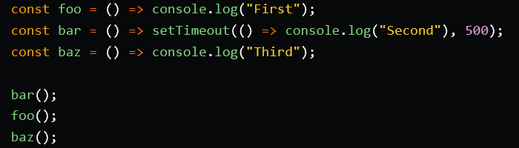
Here is a quick demo for you
Courtesy of https://dev.to/lydiahallie/javascript-visualized-event-loop-3dif
Notes:
Courtesy of https://dev.to/lydiahallie/javascript-visualized-event-loop-3dif

Slide 44
General Rules for Writing Asynchronous Code
You can’t return a value from a promise to an ordinary procedure.
You can only send the value to another promise that is awaiting it.
Call async procedures only from other async functions or from the top level.
Break up any long-running computation into async/await segments so other processes will have a chance to run.
Leverage concurrency when possible
Use promise.all if you need to wait for multiple promises to return (or Promise.allSettled, if needed).
Check for errors with try/catch

Slide 45
Odds and Ends You Should Know

Slide 46
Async/await code is compiled into promise/then code. Using await is preferred
async function makeThreeSerialRequests(){ 1. console.log('Making first request’); 2. await makeOneGetRequest(); 3. console.log('Making second request’); 4. await makeOneGetRequest(); 5. console.log('Making third request’); 6. await makeOneGetRequest(); 7. console.log('All done!'); } makeThreeSerialRequests();
console.log('Making first request'); makeOneGetRequest().then( () =>{ console.log('Making second request'); return makeOneGetRequest(); }).then(() => { console.log('Making third request'); return makeOneGetRequest(); }).then(()=>{ console.log('All done!'); });

Slide 47
Promises Enforce Ordering Through “Then”
1. console.log('Making requests');
2. axios.get('https://rest-example.covey.town/')
.then((response) =>{
console.log('Heard back from server');
console.log(response.data);
});
3. axios.get('https://www.google.com/')
.then((response) =>{
console.log('Heard back from Google');
});
4. axios.get('https://www.facebook.com/')
.then((response) =>{
console.log('Heard back from Facebook');
});
5. console.log('Requests sent!');
axios.get returns a promise.
p.then mutates that promise so that the then block is not run until after the original promise returns.
The resulting promise isn’t completed until the then block finishes.
You can chain .then’s, to get things that look like p.then().then().then()
Each then is a pause point.
Notes:
Promises enforce the order of operations only through the .then. The code in the ‘then’ won’t run until the promise is resolved. Note that every .then() is a choice point, allowing the runtime to switch to some other task.
(build through example, explaining the possible orders of results. Point out that we should never depend on the order of results we hear back form google/facebook/coveytown because it is non-deterministic. You might happen to see 9/10 times one ordering, but there is no guarantee)

Slide 48
async doesn't eliminate data races
src/Slides/dataRace.ts
import { myFetch } from './fakeRequest.ts';
const log: string[] = [];
async function X(n: number) {
await myFetch(1)
log.push('X');
}
async function Y(n: number) {
await myFetch(2)
log.push('Y');
}
for (let i = 0; i < 4; i += 1) {
log.push('start');
await Promise.all([X(10), Y(20)]);
}
console.log(log);
$ node dataRace.ts
Promise created for 1
Promise created for 2
Promise created for 1
Promise created for 2
Promise created for 1
Promise created for 2
Promise created for 1
Promise created for 2
[
'start', 'X', 'Y',
'start', 'Y', 'X',
'start', 'Y', 'X',
'start', 'Y', 'X'
]
Notes:
We've already seen non-deterministic behavior reflected in our console logs. But that kind of behavior can easily become visible to our program. All you need is some shared state across your promises.

Slide 49
Review
You should now be prepared to:
Explain the difference between JS run-to-completion semantics and interrupt-based semantics.
Given a simple program using async/await, work out the possible orders in which the statements in the program will run.
Write simple programs that create and manage promises using async/await
Write simple programs to mask latency with concurrency by using non-blocking IO and Promise.all in TypeScript.
Notes:
<read slide>

